Slide 1
Trajectories For no Berry Curvature and For Constant Curvature

Slide 2
Index
Constant omega and E, no B: slides 3-20
Constant B, No E, No omega: slides 21-23
Monopole omega with E, no B: slides 24-39
Monopole omega, with E, no B and different boundary conditions: slides 40-55
Two omega monopoles of opposite chirality, with E, no B: slides 56-65
Full omega with opposite chirality, with E, no B: slides 66-77
Updates: slides 78-79

Slide 3
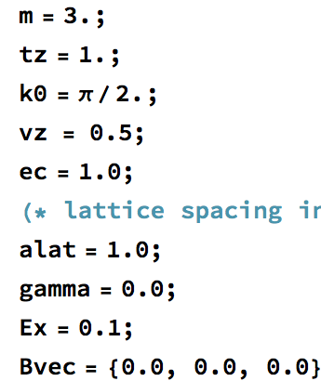
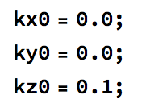
Model: Type II Model with Gamma=0
Initial Conditions:

Slide 4
Constant Berry Curvature and E, No B
In direction perpendicular to the initial momentum

Slide 5
Direction of Fields
E=0.1 in the +x direction
Omega=0.1 in the +y direction

Slide 6
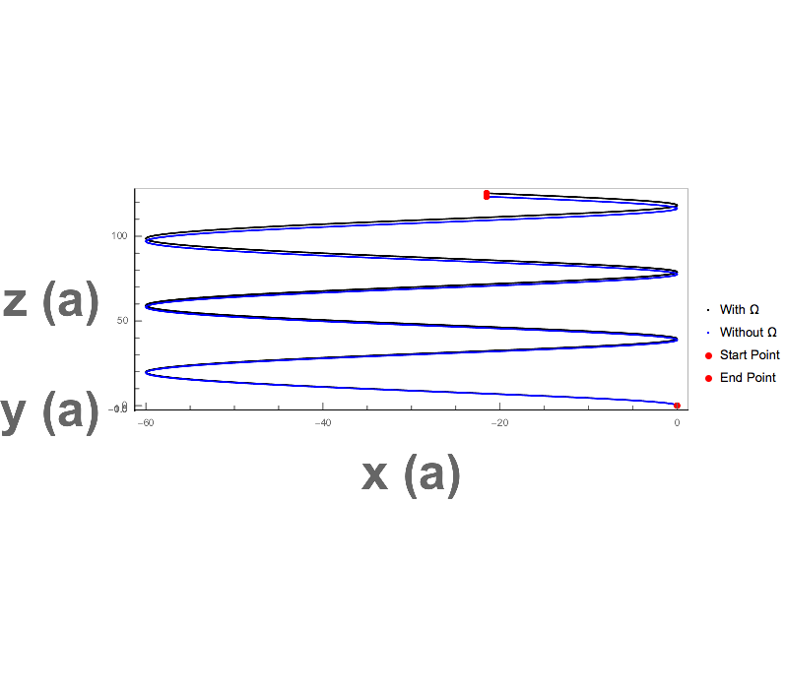
Constant Berry Curvature and E, No B

Slide 7
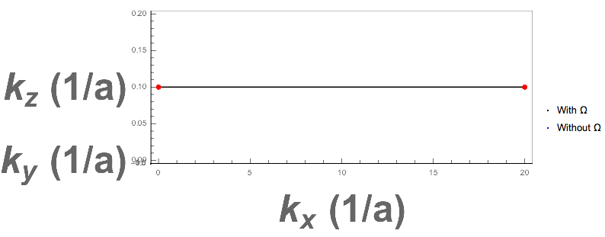
Constant Berry Curvature and E, No B

Slide 8
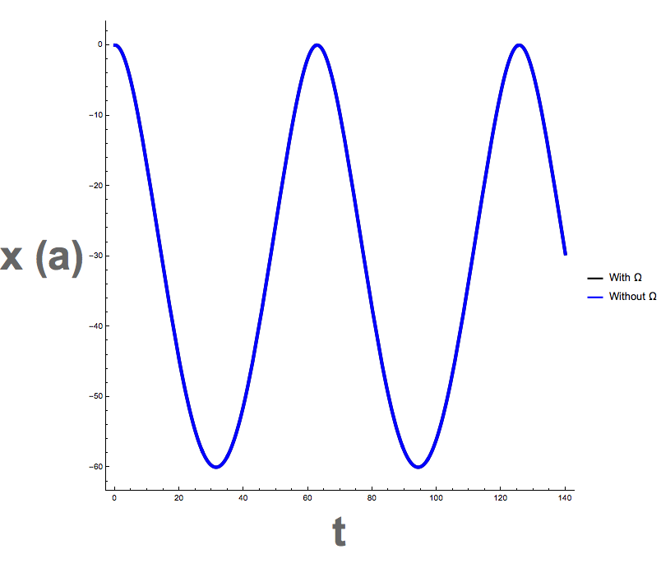
Constant Berry Curvature and E, No B

Slide 9
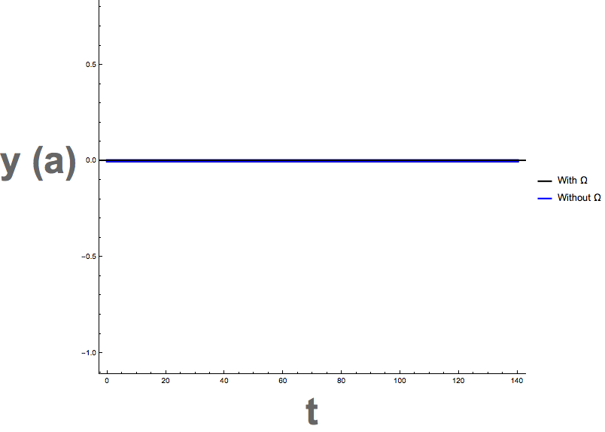
Constant Berry Curvature and E, No B

Slide 10
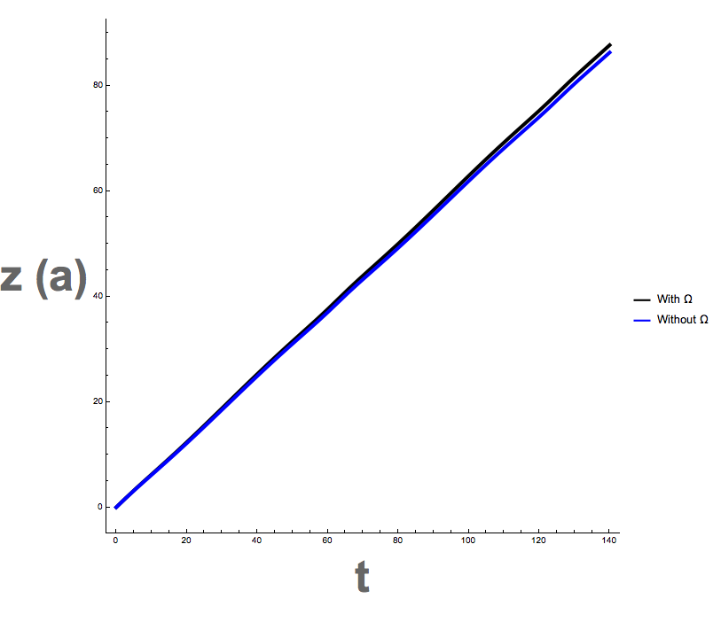
Constant Berry Curvature and E, No B

Slide 11
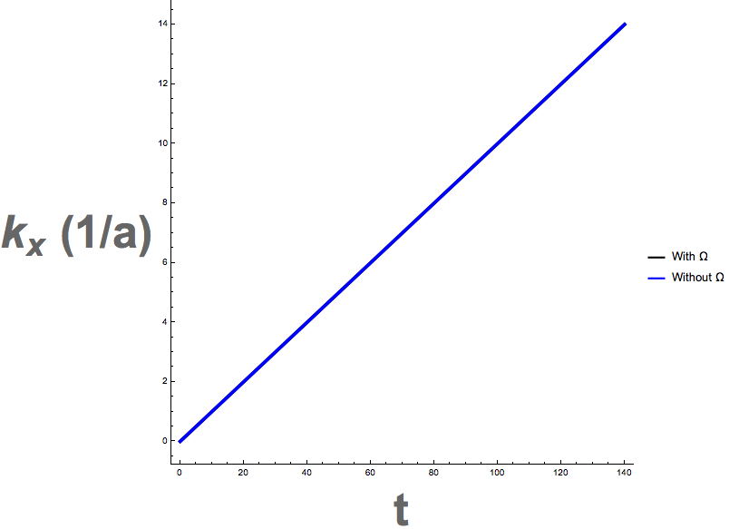
Constant Berry Curvature and E, No B

Slide 12
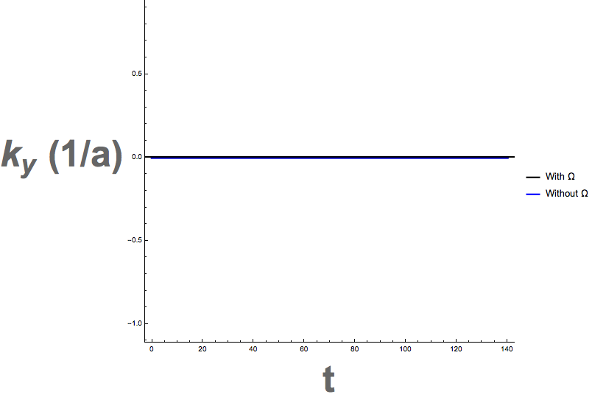
Constant Berry Curvature and E, No B

Slide 13
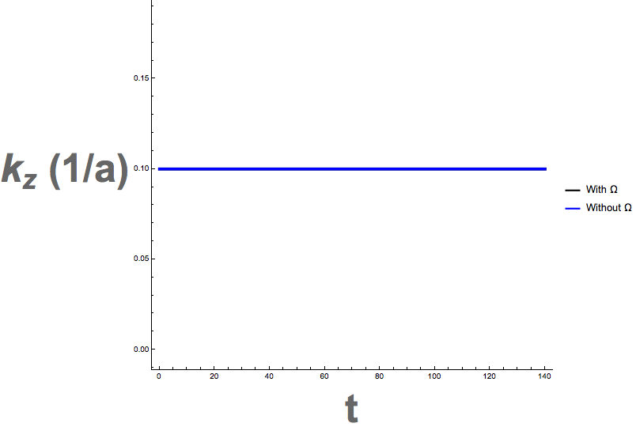
Constant Berry Curvature and E, No B

Slide 14
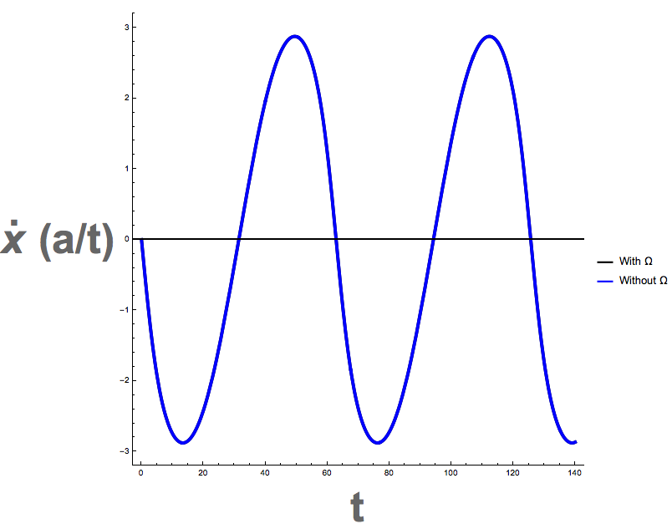
Constant Berry Curvature and E, No B

Slide 15
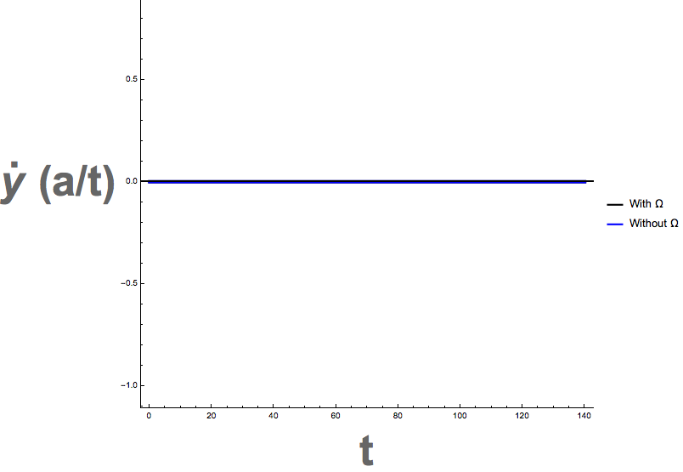
Constant Berry Curvature and E, No B

Slide 16
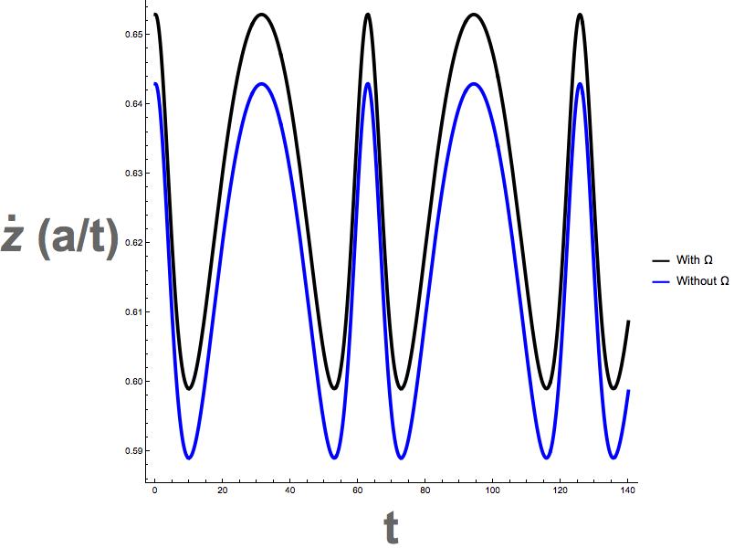
Constant Berry Curvature and E, No B

Slide 17
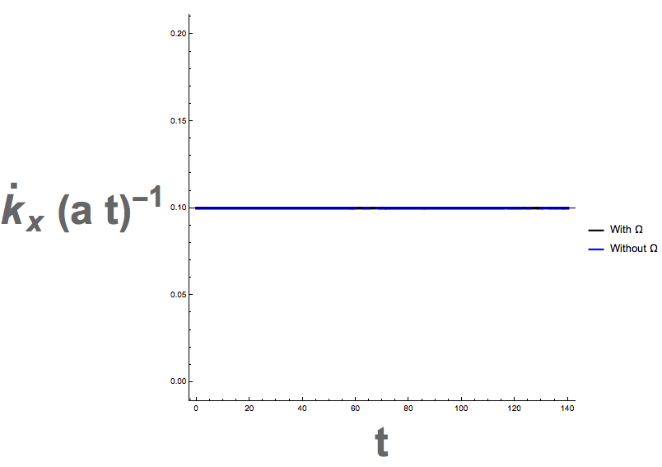
Constant Berry Curvature and E, No B

Slide 18
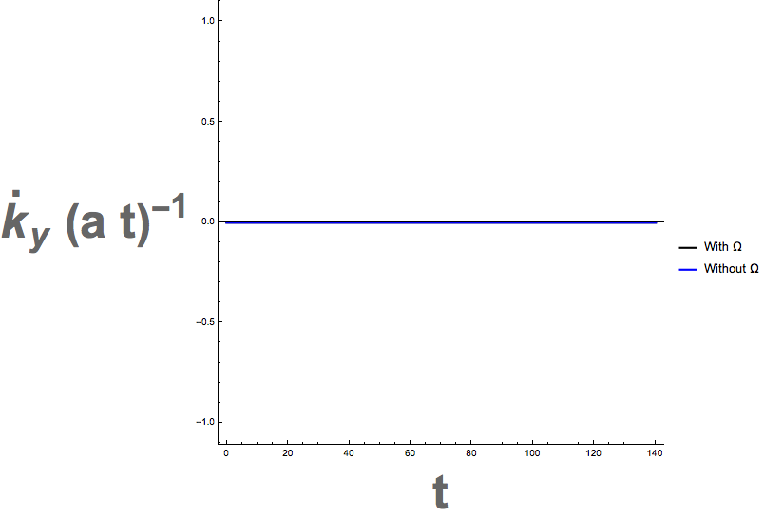
Constant Berry Curvature and E, No B

Slide 19
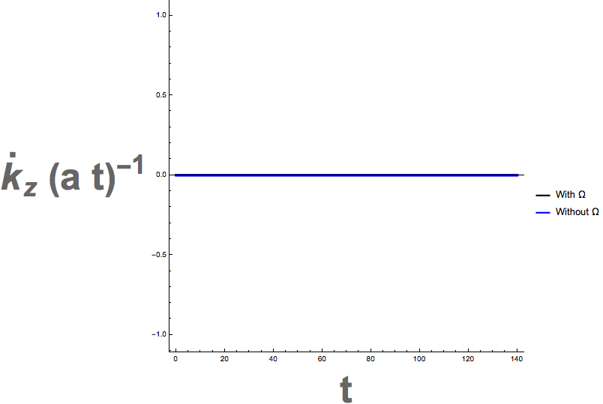
Constant Berry Curvature and E, No B

Slide 20
Constant Berry Curvature and E, No B

Slide 21
No Berry Curvature, no E, Just B
Also, B field is perpendicular to the initial k0

Slide 22
No Berry Curvature, No E, Just B
Show direction of B along y

Slide 23
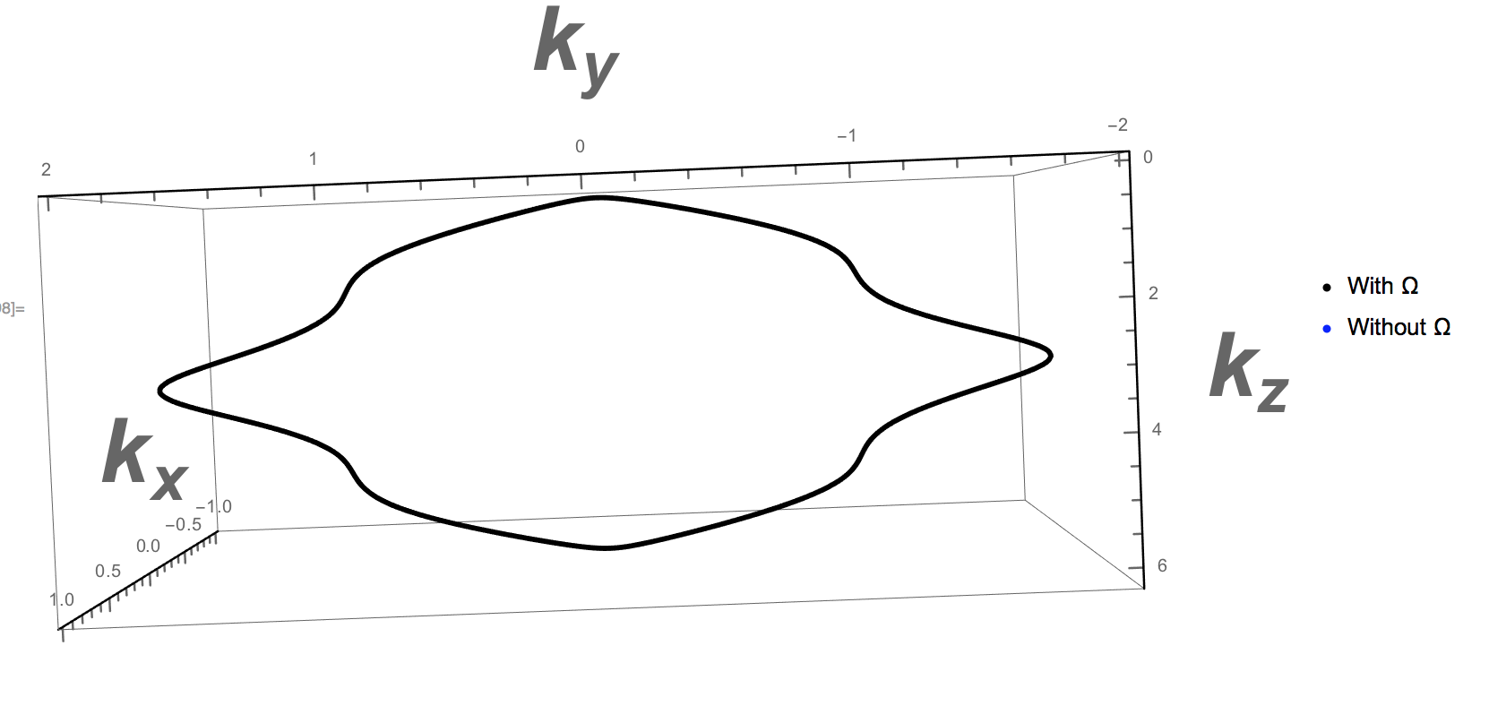
No Berry Curvature, No E, Just B

Slide 24
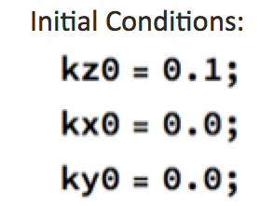
Monopole Berry Curvature and E, No B
E=0.1 in x direction

Slide 25
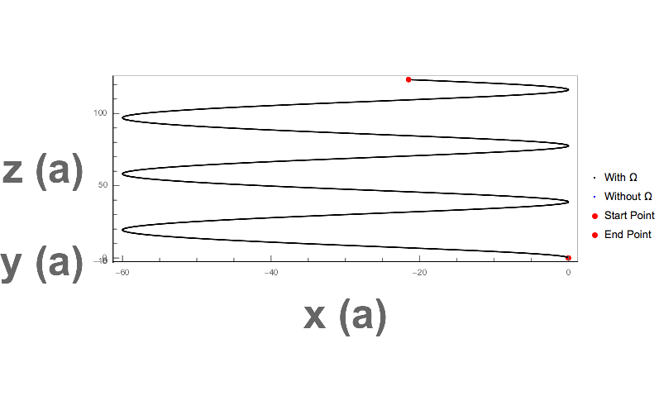
Monopole Berry Curvature and E, No B

Slide 26
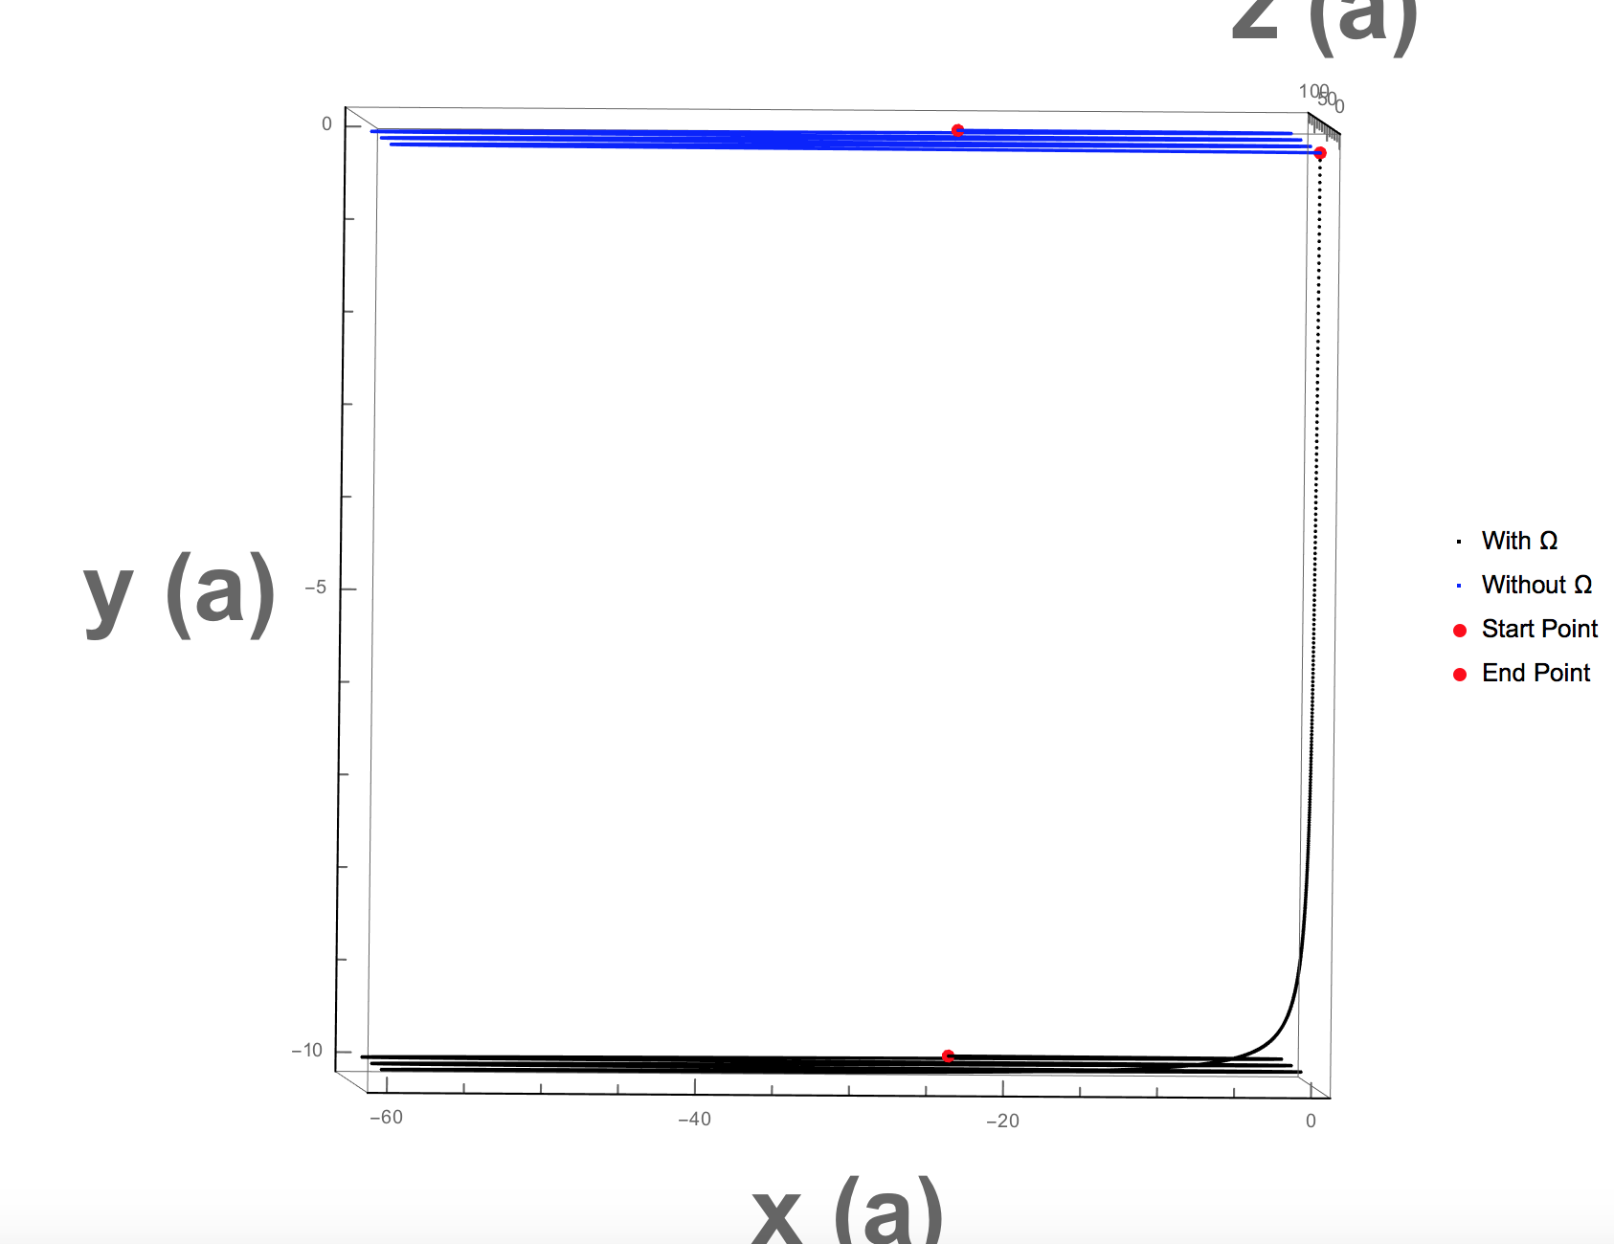
Monopole Berry Curvature and E, No B

Slide 27

Monopole Berry Curvature and E, No B

Slide 28

Monopole Berry Curvature and E, No B

Slide 29
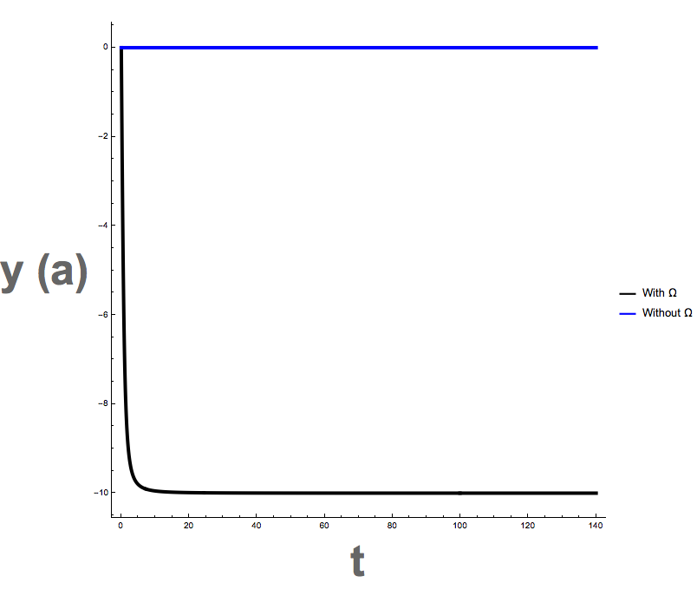
Monopole Berry Curvature and E, No B

Slide 30
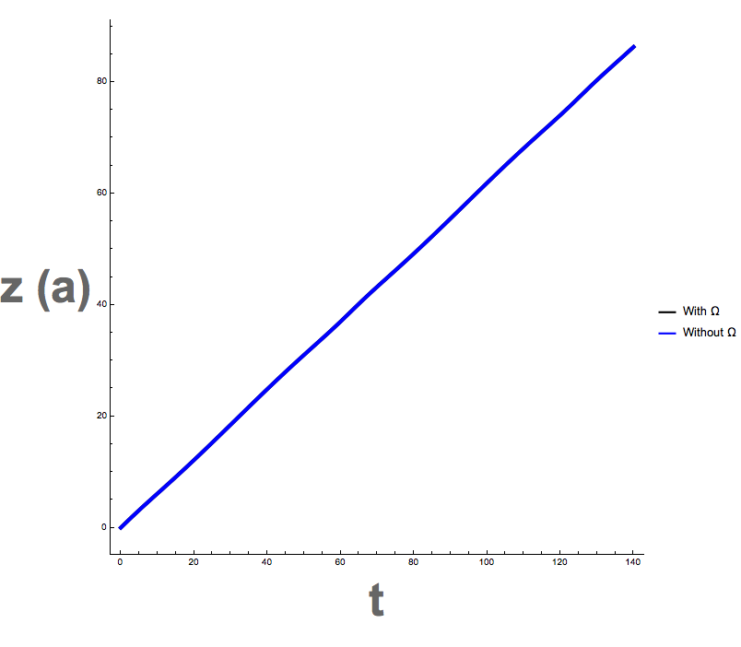
Monopole Berry Curvature and E, No B

Slide 31
Monopole Berry Curvature and E, No B

Slide 32
Monopole Berry Curvature and E, No B

Slide 33
Monopole Berry Curvature and E, No B

Slide 34

Monopole Berry Curvature and E, No B

Slide 35
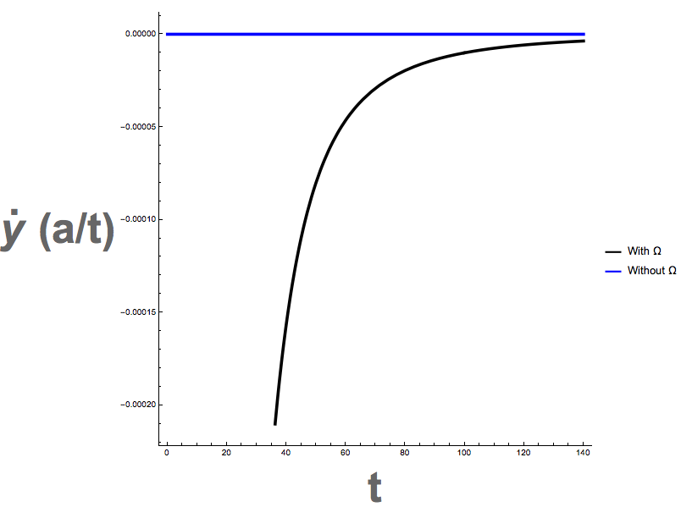
Monopole Berry Curvature and E, No B

Slide 36
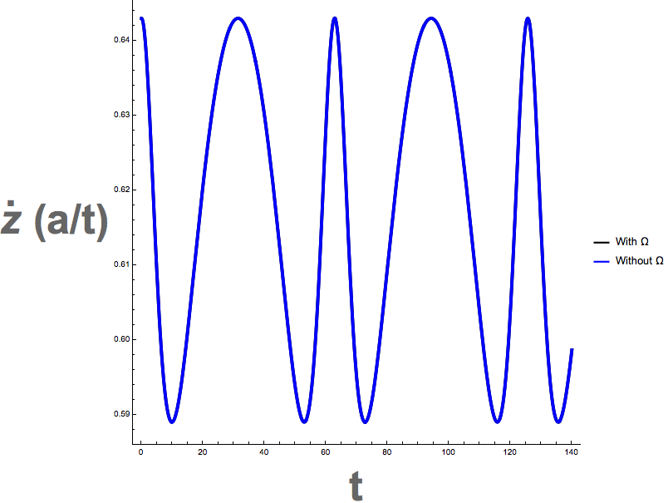
Monopole Berry Curvature and E, No B

Slide 37
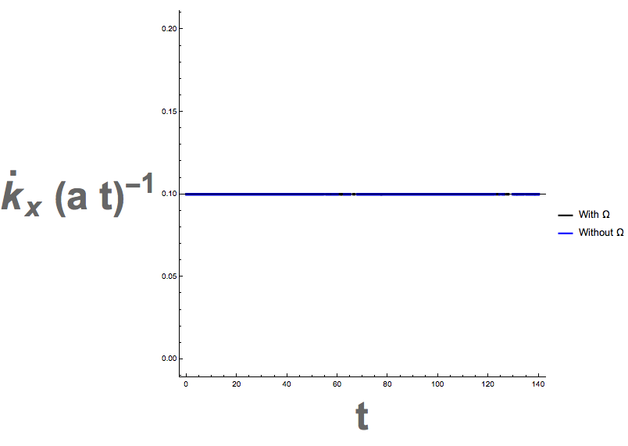
Monopole Berry Curvature and E, No B

Slide 38
Monopole Berry Curvature and E, No B

Slide 39
Monopole Berry Curvature and E, No B

Slide 40
Monopole Berry Curvature with kx0=ky0=kz0=0.1

Slide 41
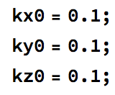
Monopole Berry Curvature with kx0=ky0=kz0=0.1
E=0.1 in x direction

Slide 42
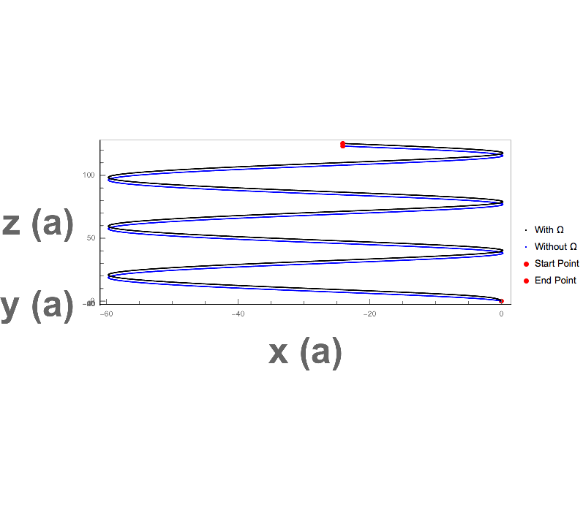
Monopole Berry Curvature with kx0=ky0=kz0=0.1

Slide 43

Monopole Berry Curvature with kx0=ky0=kz0=0.1

Slide 44
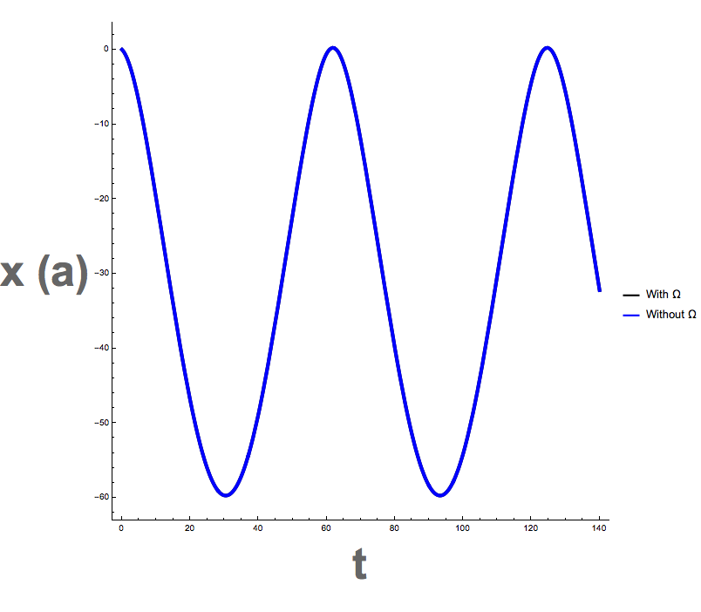
Monopole Berry Curvature with kx0=ky0=kz0=0.1

Slide 45
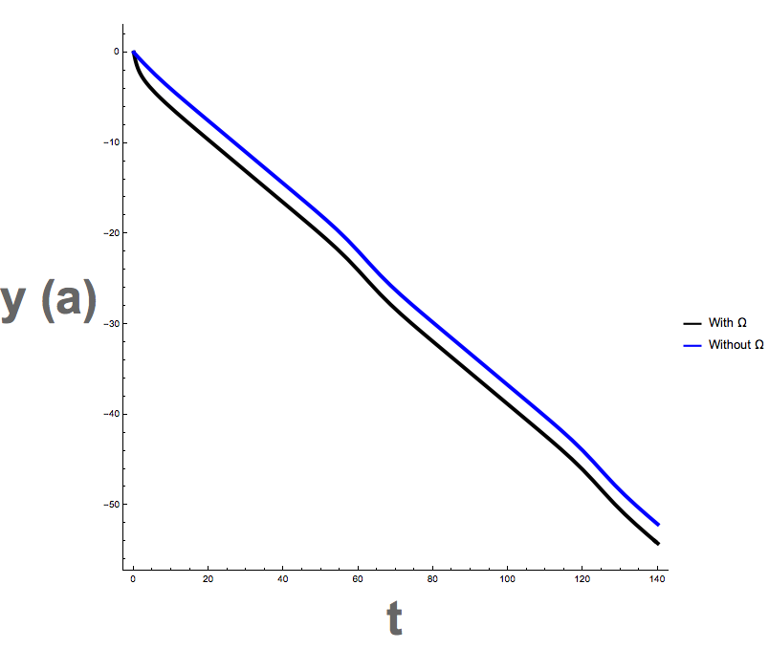
Monopole Berry Curvature with kx0=ky0=kz0=0.1

Slide 46
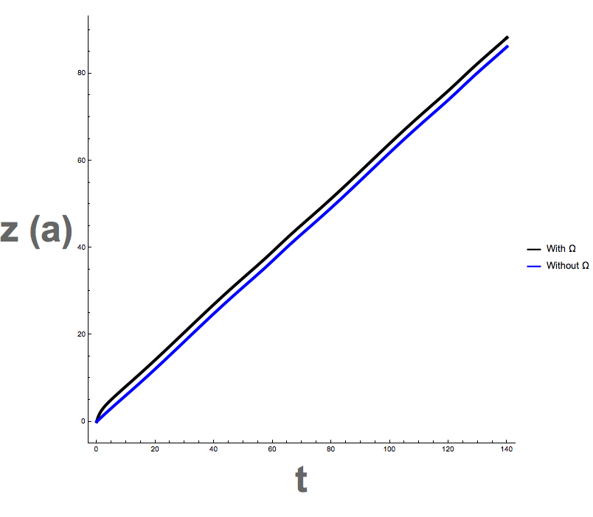
Monopole Berry Curvature with kx0=ky0=kz0=0.1

Slide 47
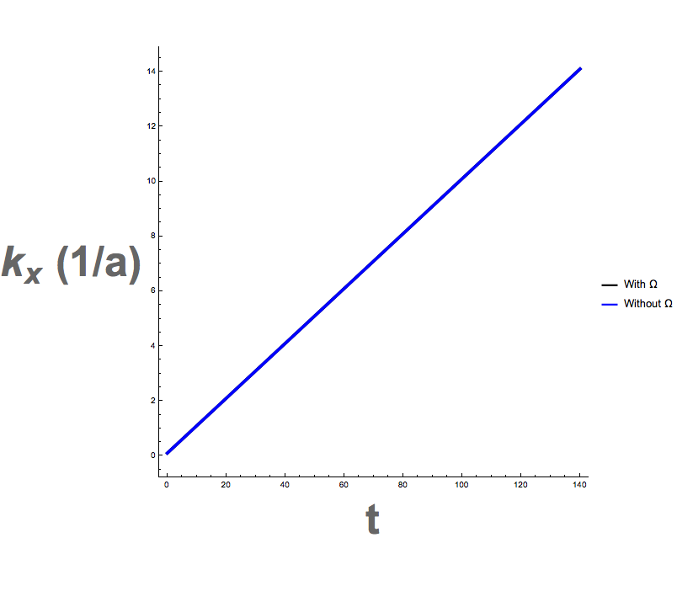
Monopole Berry Curvature with kx0=ky0=kz0=0.1

Slide 48
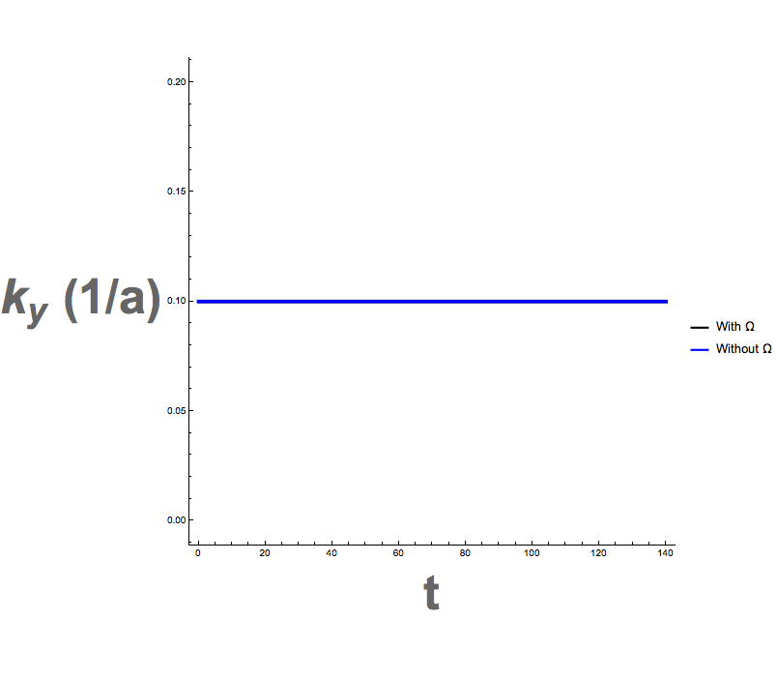
Monopole Berry Curvature with kx0=ky0=kz0=0.1

Slide 49
Monopole Berry Curvature with kx0=ky0=kz0=0.1

Slide 50
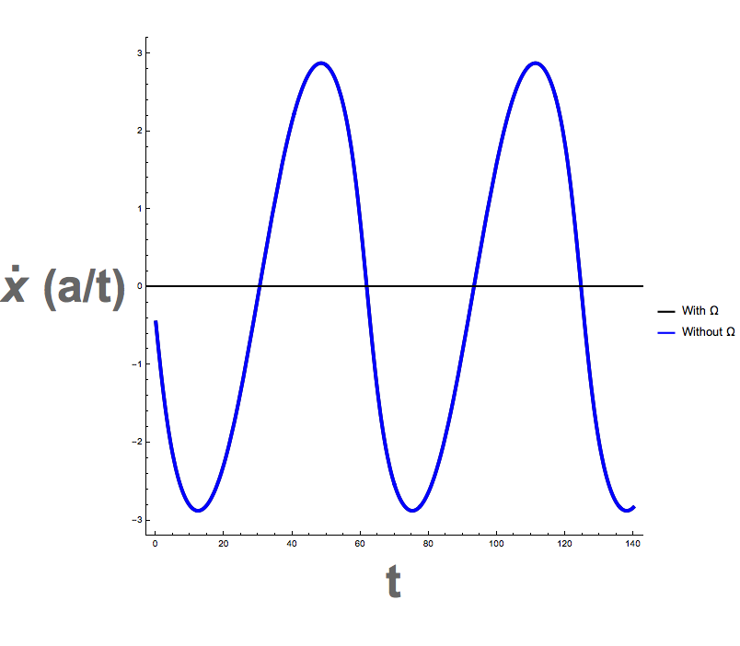
Monopole Berry Curvature with kx0=ky0=kz0=0.1

Slide 51
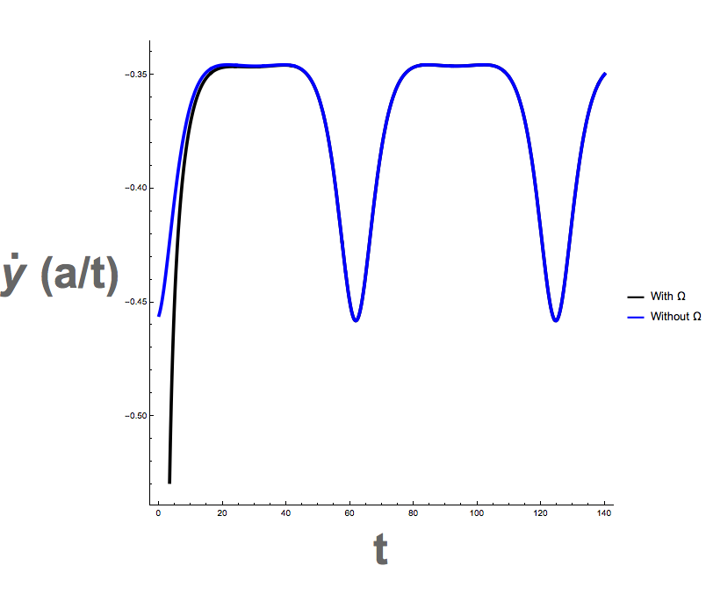
Monopole Berry Curvature with kx0=ky0=kz0=0.1

Slide 52
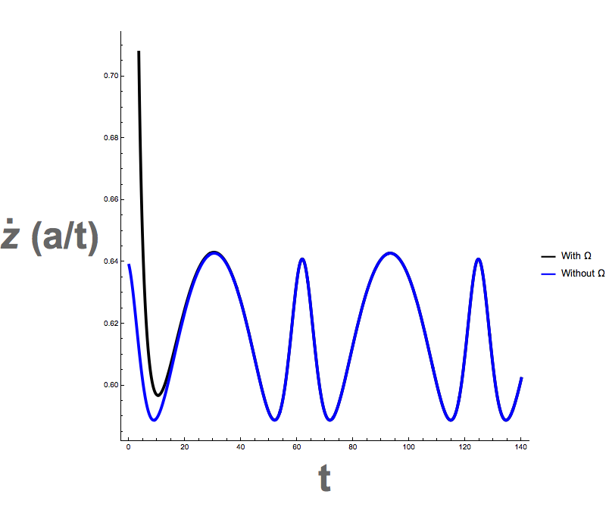
Monopole Berry Curvature with kx0=ky0=kz0=0.1

Slide 53

Monopole Berry Curvature with kx0=ky0=kz0=0.1

Slide 54
Monopole Berry Curvature with kx0=ky0=kz0=0.1

Slide 55
Monopole Berry Curvature with kx0=ky0=kz0=0.1

Slide 56
Two Monopoles of Omega in Opposite Chirality and E, No B
E=0.1 in x direction
(+) Monopole at Pi/2 and (-) monopole at Pi. Both on kx axis.

Slide 57
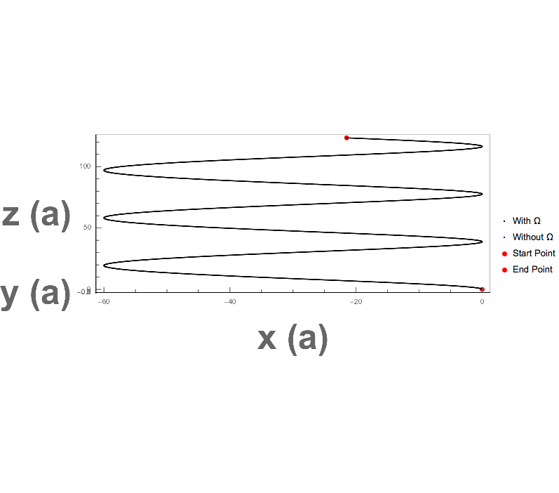
Two Monopoles of Omega in Opposite Chirality and E, No B

Slide 58
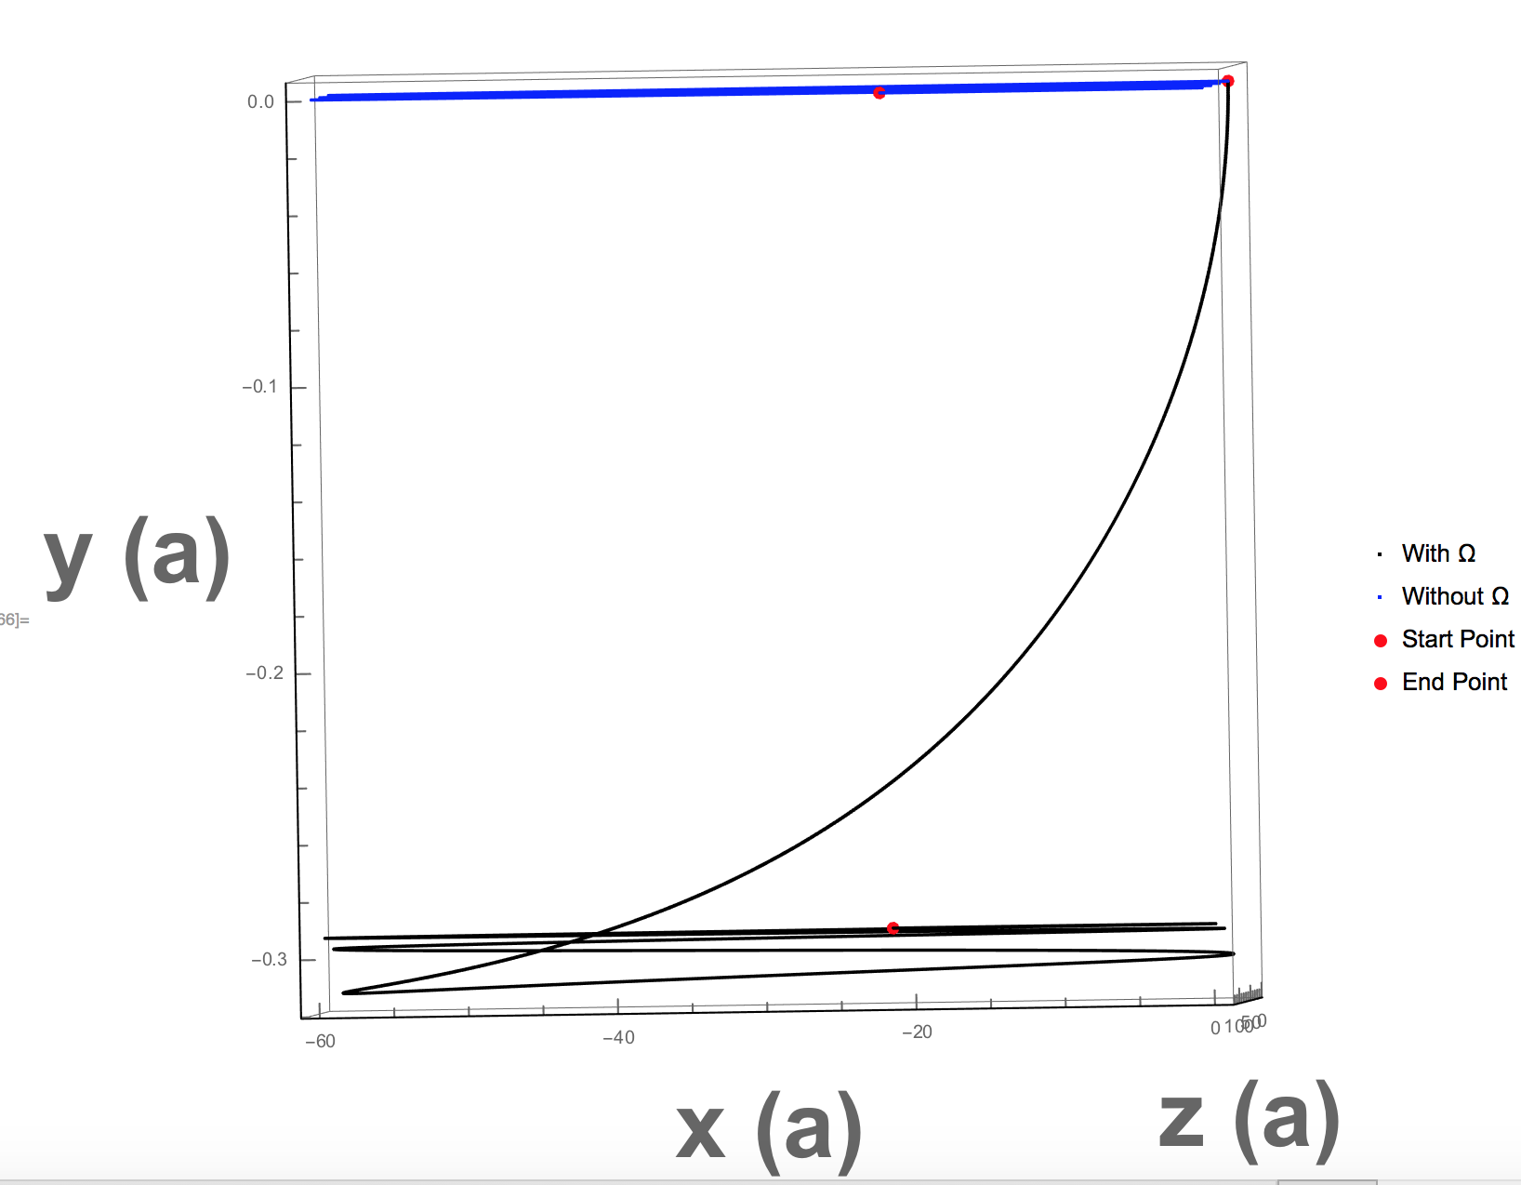
Two Monopoles of Omega in Opposite Chirality and E, No B

Slide 59

Two Monopoles of Omega in Opposite Chirality and E, No B

Slide 60
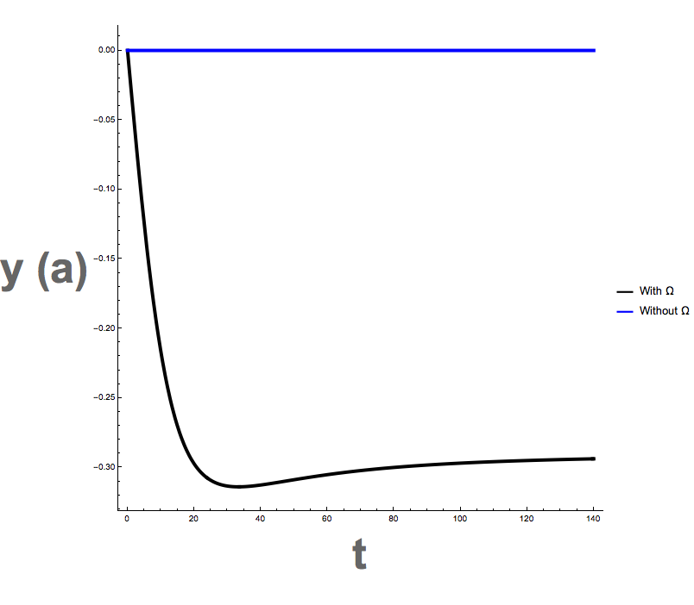
Two Monopoles of Omega in Opposite Chirality and E, No B

Slide 61
Two Monopoles of Omega in Opposite Chirality and E, No B

Slide 62
Two Monopoles of Omega in Opposite Chirality and E, No B
Crystal momentum plots are the same as before

Slide 63

Two Monopoles of Omega in Opposite Chirality and E, No B

Slide 64
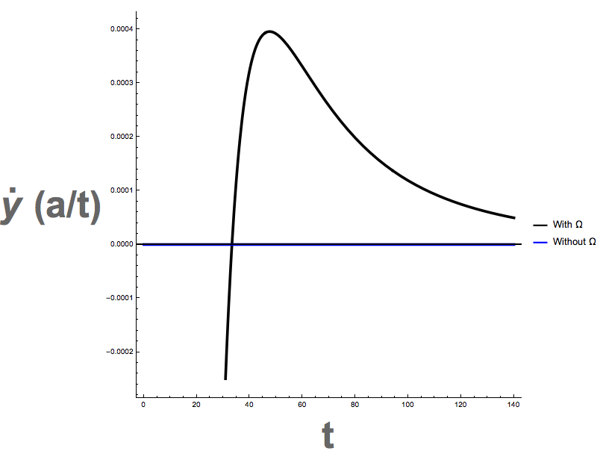
Two Monopoles of Omega in Opposite Chirality and E, No B

Slide 65
Two Monopoles of Omega in Opposite Chirality and E, No B
The k and kdot plots are the same as before

Slide 66
Full Berry Curvature in Opposite Chirality and E, No B
E=0.1 in x direction
(+) Omega at Pi/2 and (-) Omega at Pi. Both on kx axis.

Slide 67

Full Berry Curvature in Opposite Chirality and E, No B

Slide 68
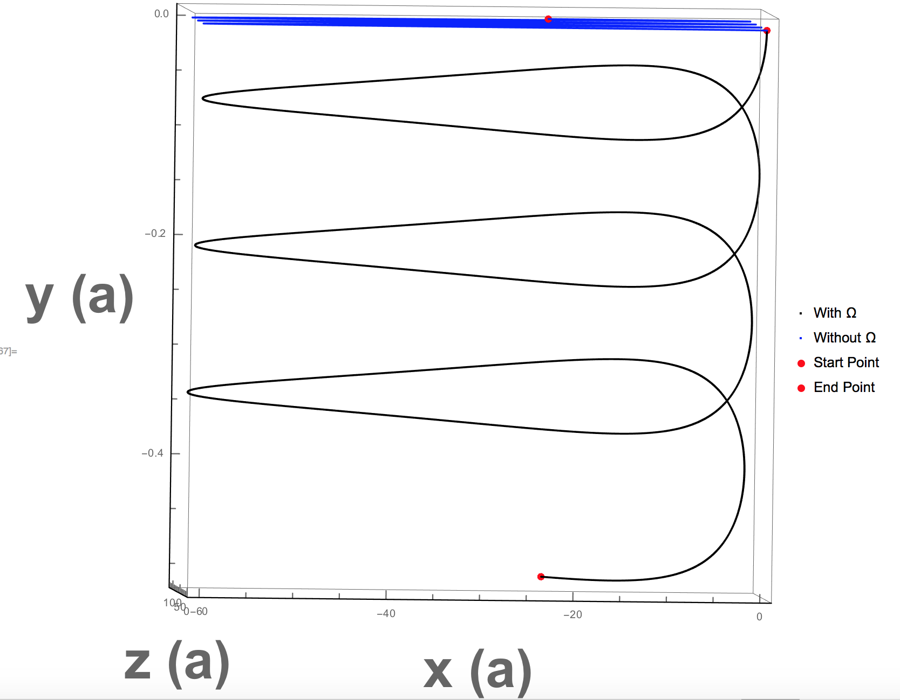
Full Berry Curvature in Opposite Chirality and E, No B

Slide 69
Full Berry Curvature in Opposite Chirality and E, No B
Momentum Plot the same as before

Slide 70

Full Berry Curvature in Opposite Chirality and E, No B

Slide 71
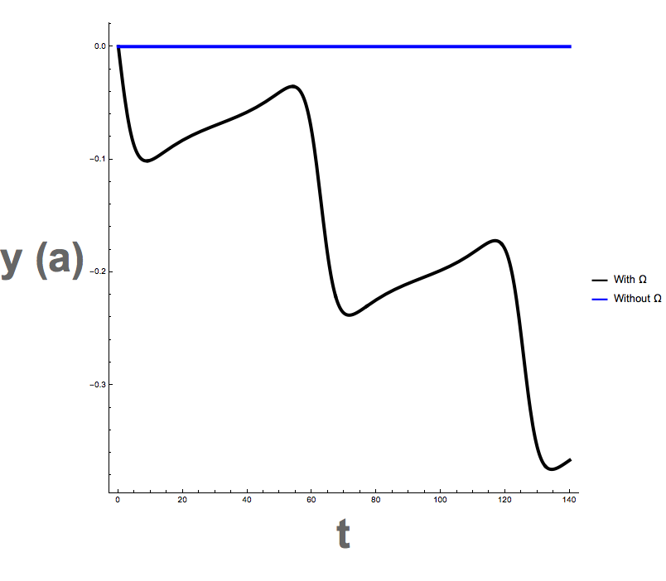
Full Berry Curvature in Opposite Chirality and E, No B

Slide 72
Full Berry Curvature in Opposite Chirality and E, No B

Slide 73
Full Berry Curvature in Opposite Chirality and E, No B
Kx, ky, kz same as previous cases

Slide 74

Full Berry Curvature in Opposite Chirality and E, No B

Slide 75
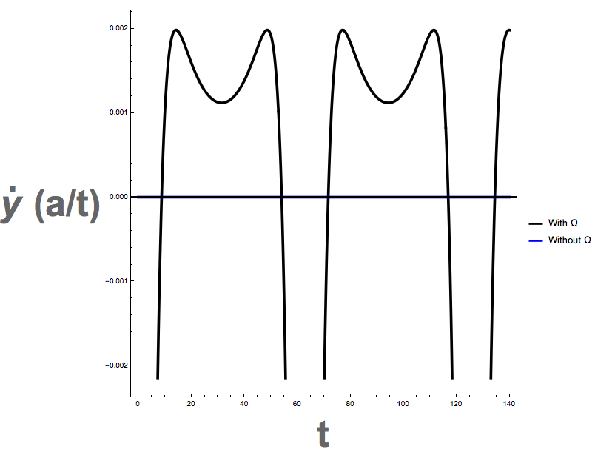
Full Berry Curvature in Opposite Chirality and E, No B

Slide 76

Full Berry Curvature in Opposite Chirality and E, No B

Slide 77
Full Berry Curvature in Opposite Chirality and E, No B
Kdot plots the same as previous plots

Slide 78
Summary of Discussion Points (10/07/17)
Changes to be Made:
  Make axes as: x being horizontal, y into page, z vertical
  Mark initial and ending points
  Plot x(t) vs t, y(t) vs t, z(t) vs t, kx(t) vs t, ky(t) vs t, kz(t) vs t in 6 separate plots
  Plot the time derivatives of x(t) vs t, y(t) vs t, z(t) vs t, kx(t) vs t, ky(t) vs t, kz(t) vs t in 6 separate plots
Variation: B field in z
  Momentum along z
  Momentum along x
Next Steps:
  Plot with single monopole of Berry curvature (No B, No E)
  Plot with two monopoles of opposite chirality (No B, No E)
Consider whether Berry curvature is strong enough for Cherenkov radiation to become relevant
  Starting reading up on Cherenkov radiation

Slide 79
Summary of Discussion Points (10/30/17)
Make omega in y direction
Make E in x direction
State what direction B is in

